Slide 1
Bank Management System
Tugas Besar PBO - Kelompok “manajer”
Anggota :
- Ihza Fajrur Achmad Hasani (119140130)
- Kevin Tanuwijaya (119140207)
- Resya Lianti (119140045)

Slide 2
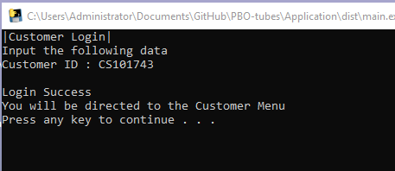
Fitur Program (1)
1. Customer Login (Main Menu)

Slide 3
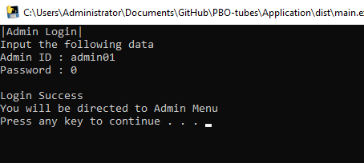
Fitur Program (2)
2. Admin Login (Main Menu)

Slide 4
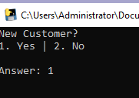
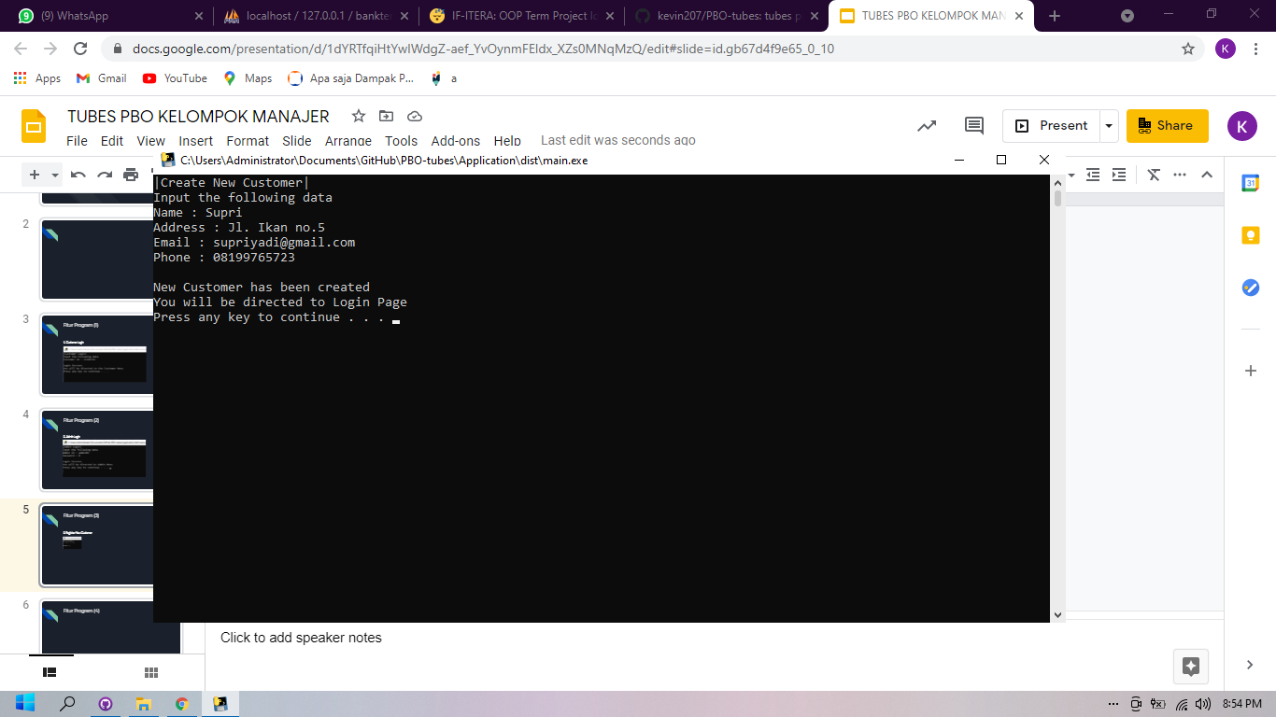
Fitur Program (3)
3. Register New Customer (Main Menu)

Slide 5

Fitur Program (4)
4. Create Account (Customer Menu)

Slide 6
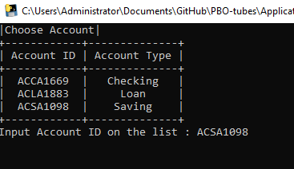
Fitur Program (5)
5. Acces Account (Customer Menu)

Slide 7
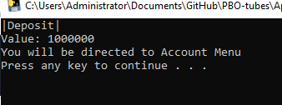

Fitur Program (6 & 7)
6. Deposit (Account Menu)
7. Withdraw (Account Menu)

Slide 8
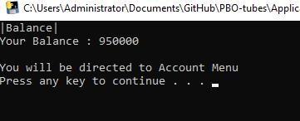
Fitur Program (8)
8. Balance Enquiry (Account Menu)

Slide 9

Fitur Program (9)
9. Transaction History (Account Menu)

Slide 10
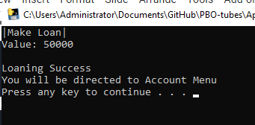
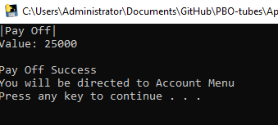
Fitur Program (10 & 11)
10. Loan (Loan Account Menu)
11. Pay Off (Loan Account Menu)

Slide 11

Fitur Program (12)
12. Loan Balance/Debt Inquiry (Loan Account Menu)

Slide 12



Fitur Program (13)
13. Logout (Admin Menu & Customer Menu)

Slide 13
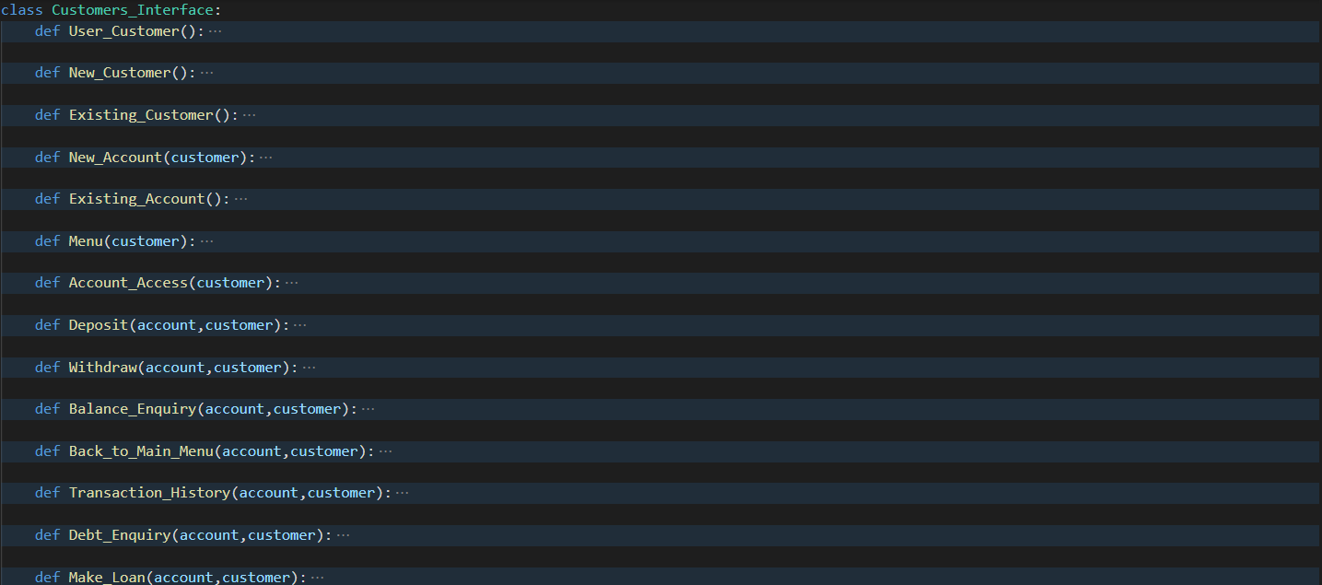
Penerapan Object oriented programming (OOP)
1. Modularity, pemecahan fungsi menjadi beberapa sub program

Slide 14
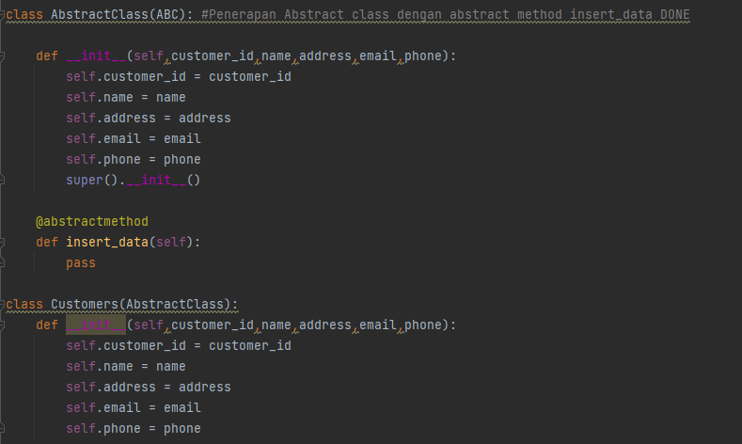
Penerapan Object oriented programming (OOP)
2. Abstract Class

Slide 15
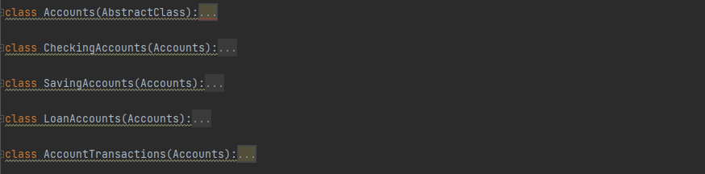
Penerapan Object oriented programming (OOP)
3. Inheritance
Parent Class : Account
Child Class:
CheckingAccounts
Saving Accountss
LoanAccounts
AccountTransactions

Slide 16
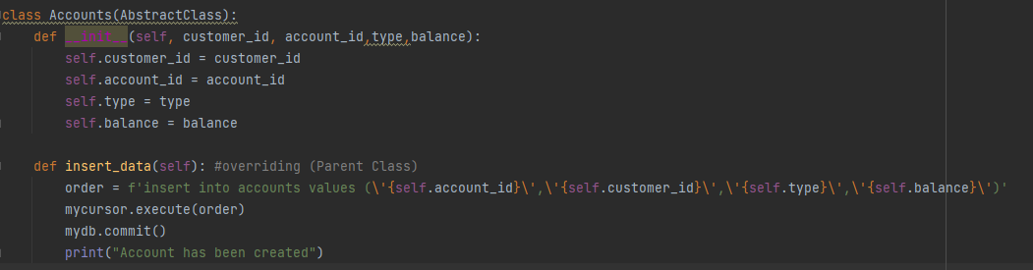
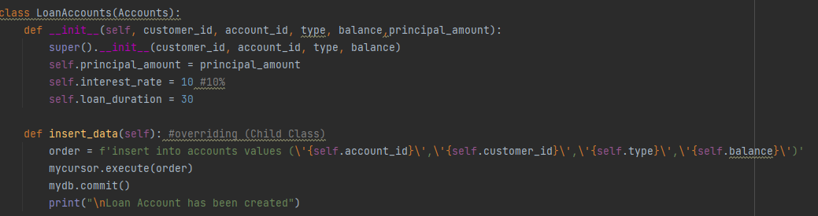
Penerapan Object oriented programming (OOP)
4. Overriding

Slide 17
DEMO PROGRAM APLIKASI

